Slide 1

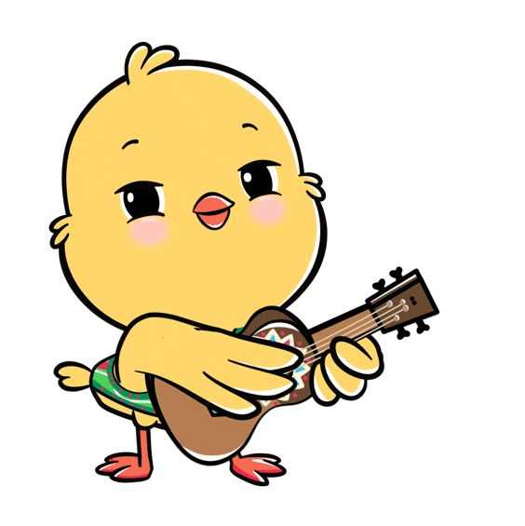

Slide 2

Warm-up

Slide 3

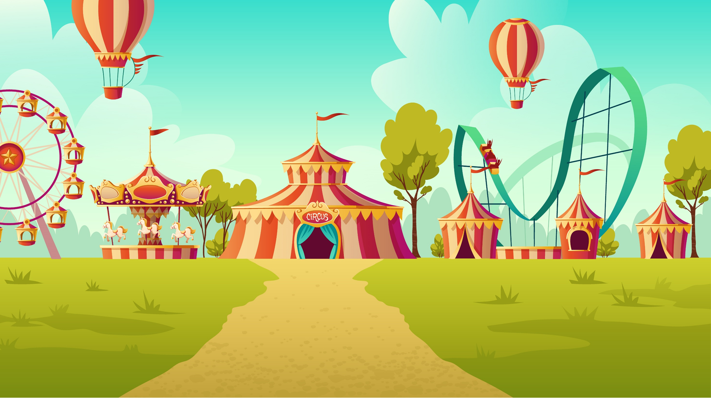
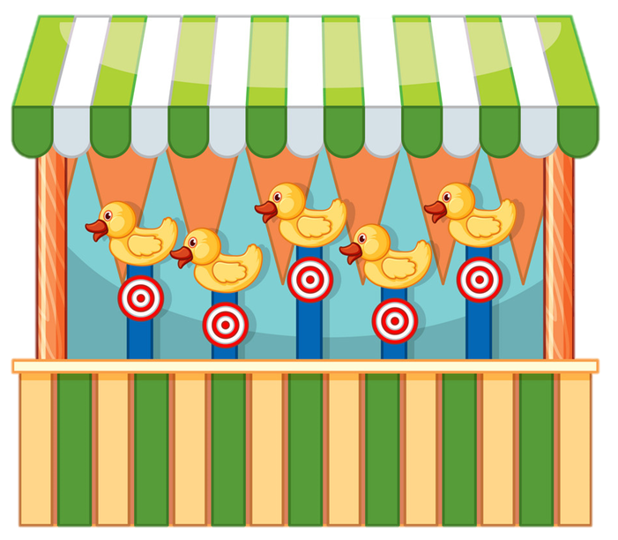

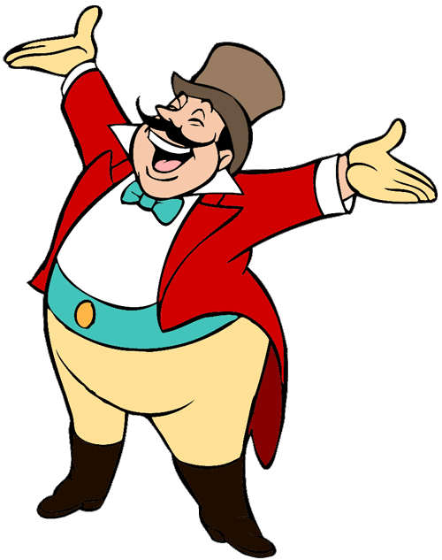
START

Slide 4




A. pen
B. red
C. pencil
Next

Slide 5

A. pencil
B. pen
C. bell

Slide 6

A. pencil
B. pen
C. ruler
Next

Slide 7
Choose the odd
one out.
duck, dog, red
cat,
A. red
B. cat
C. dog
Next

Slide 8

Look, listen
and choose.
A. Yes
B. No

Slide 9

Look, listen
and choose.
A. Yes
B. No

Slide 10

Look, listen
and choose.
A. Yes
B. No
Click on the letters A, B or C to choose.
Next

Slide 11
Look, listen
and choose.
A. Yes
B. No
Click on the letters A, B or C to choose.
Next

Slide 12
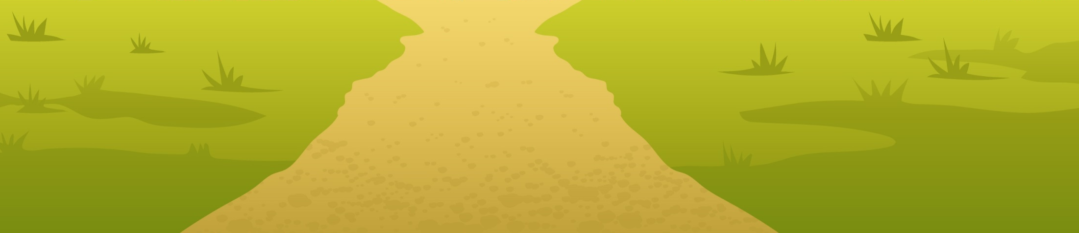

Well done!

Slide 13

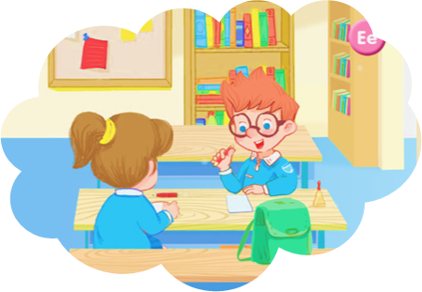
Wednesday, Demcember 3rd 2025
Unit 6
In the classroom

Slide 14






Contents
Listen and repeat.
Let’s talk.
Let’s sing!

Slide 15

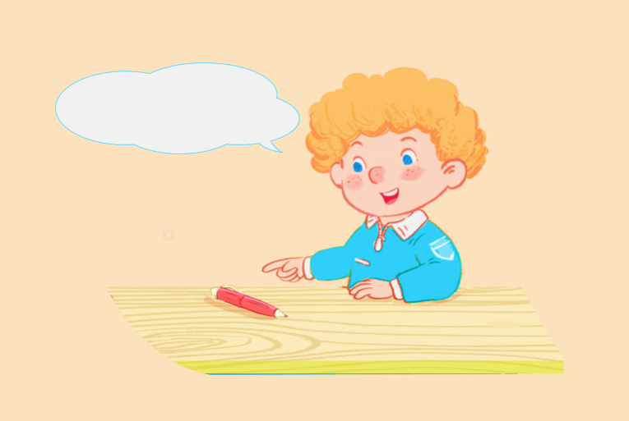

6. Listen and repeat.
It’s a red pen.

Slide 16

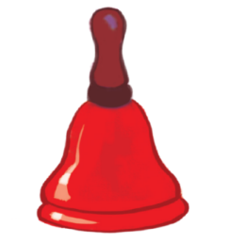
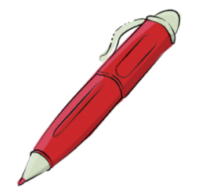
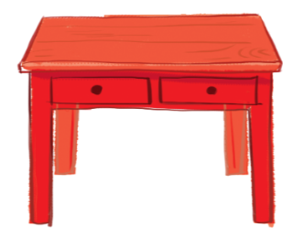
Sentence pattern
it’s = it is
It’s a red ___.
pencil
bell
pen
desk

Slide 17
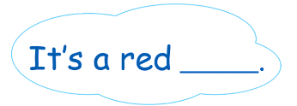

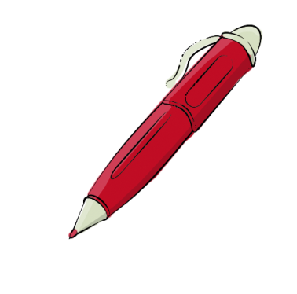

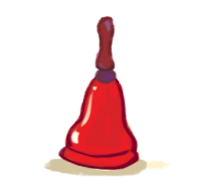
7.Let’s talk.
it’s = it is
a
b
c
d

Slide 18
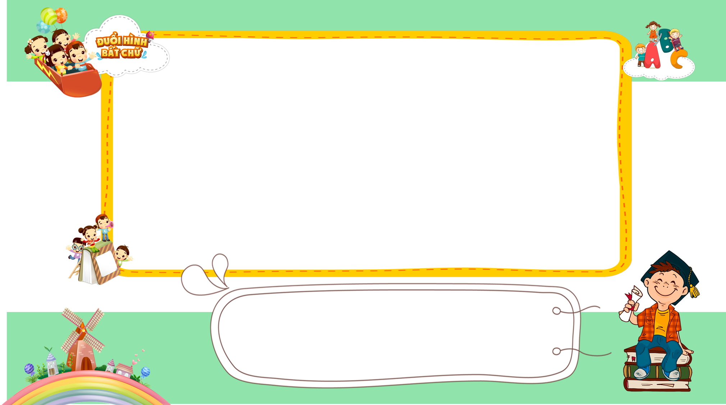
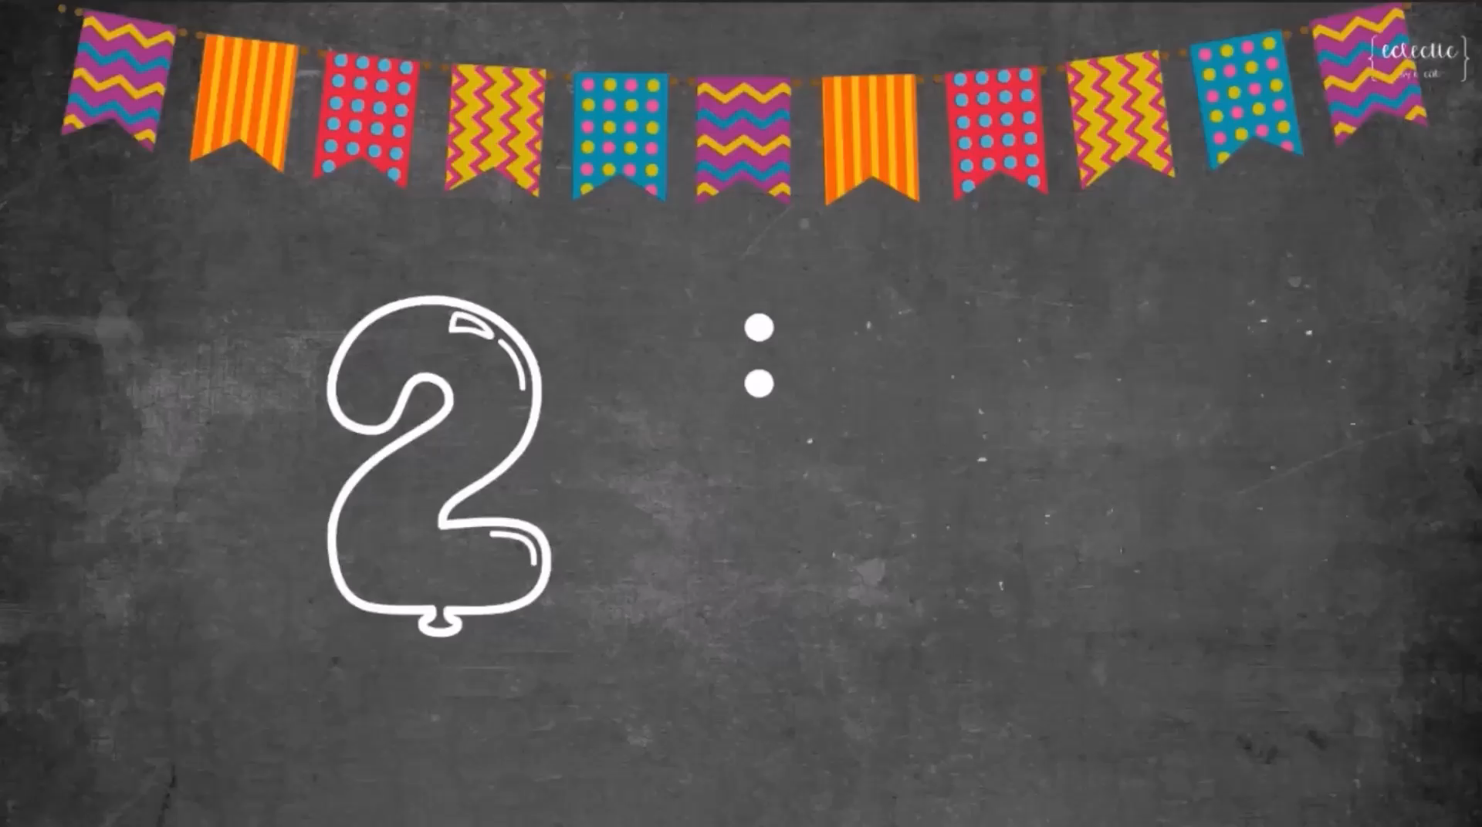


A: _______________________
B: I’d like to be a doctor.
8/8
Next
What would you like to be in the future?
Answer

Slide 19

7.Let’s talk.
pencil
It’s a red _____.
a

Slide 20
7.Let’s talk.
pen
It’s a red ____.
b

Slide 21
7.Let’s talk.
desk
It’s a red ____.
c

Slide 22
7.Let’s talk.
bell
It’s a red ____.
d

Slide 23
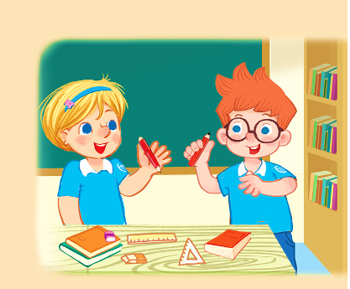








8.Let’s sing!
Hello I’m Jen.
I have a pen.
It’s red.
It’s a red pen.
This is Ben.
He has a pencil.
It’s red.
It’s a red pencil.

Slide 24

8.Let’s sing!

Slide 25

8.Let’s sing!
Hello I’m Jen.
I have a pen.
It’s red.
It’s a red pen.
This is Ben.
He has a pencil.
It’s red.
It’s a red pencil.

Slide 26
Review
it’s = it is
It’s a red ___.
pencil
bell
pen
desk

Slide 27
Homework
...............................................
...............................................

Slide 28

Thank you!

